Slide 1
AIM5011: Leveraging NLP techniques in healthcare domain for clinical domain classification
Group 5:
Lakshmikar Reddy Polamreddy
Harsha Koduri
Sai Kumar Kalisetty
Thirupathi Kadari

Slide 2
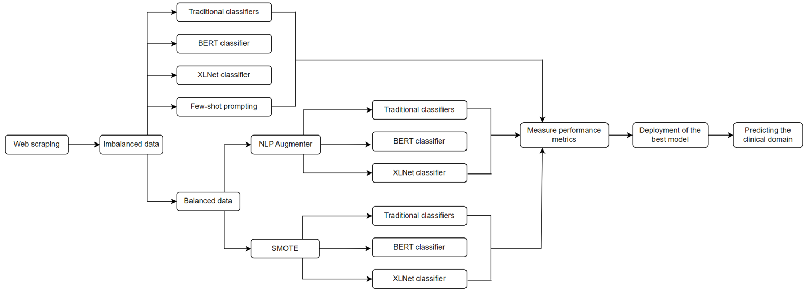
Overview
Motivation:
The exponential growth of clinical data from diverse sources such as electronic health records, medical literature, and patient-generated information necessitates advanced solutions for efficient medical record classification.
Project Objective:
To accurately classify the medical specialties(clinical domains) based on patient's medical transcriptions – to automatically predict the initial diagnostics needed for the patient and to refer the patient to the relevant department.
Approach:

Slide 3

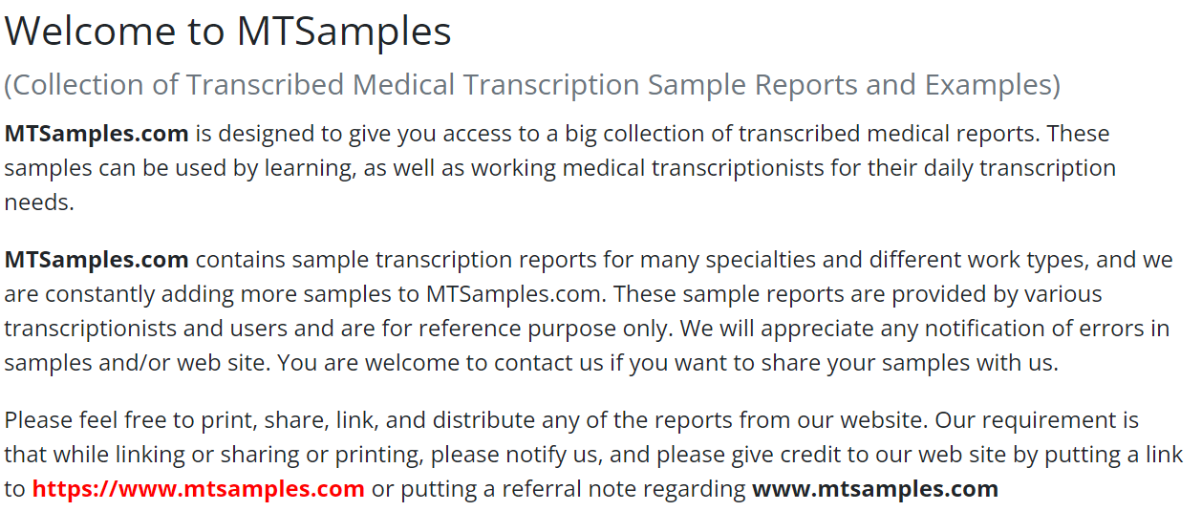
Dataset summary
Dataset Summary
Source of Information | https://mtsamples.com/
Number of samples | 5013
Types(medical specialty) | 40
Data type | Text data
Dataset preparation
Web scraping
Scraped data of digital medical transcriptions and their respective medical specialties/clinical domains from MT samples website.
Used BeautifulSoup library and html tags for web scraping
Saved the data into a csv file - Unbalanced_data.csv. Refer to SCRIPT1
Creation of Balanced data
Used NLP augmenter library to create balanced_data.csv file
Generated 1500 samples per category. Refer to SCRIPT5
Used SMOTE algorithm. Refer to SCRIPT2

Slide 4
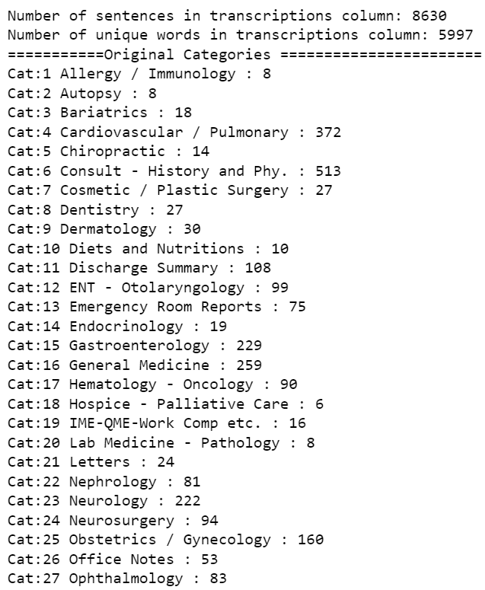
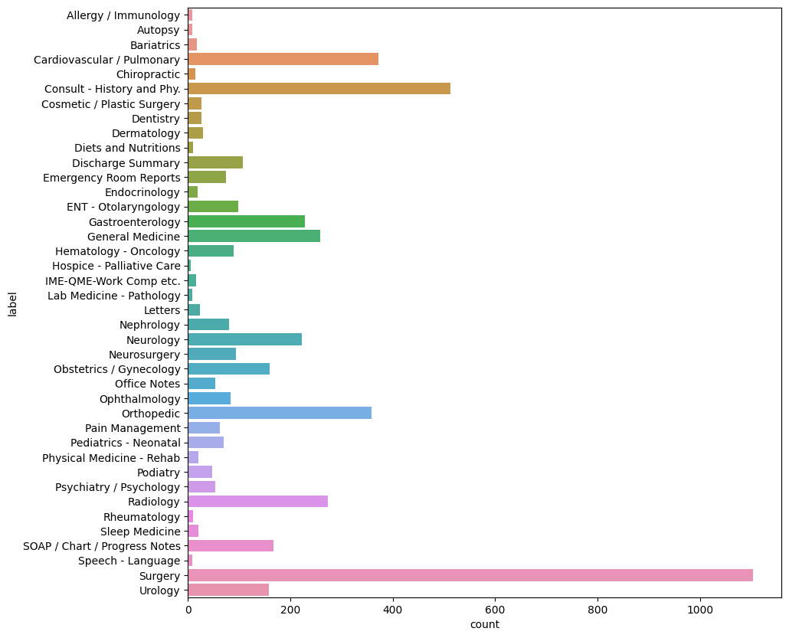
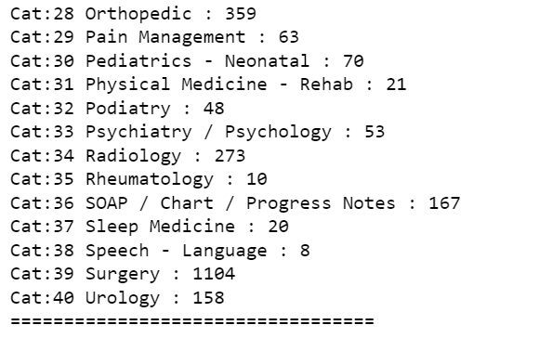
Data profiling
Refer to SCRIPT2_TRADITIONAL_CLASSIFIERS_UNBALANCED_BALANCED_SMOTE.ipynb​

Slide 5
Model building
Classical Models(SCRIPT2, SCRIPT6):
Naïve Bayes
SVM
Decision-tree
Random forest
KNN
XGBoost
Transformer models:
BERT (SCRIPT3, SCRIPT7, SCRIPT9)
XLNet (SCRIPT4, SCRIPT8, SCRIPT10)
Few-shot Prompt Engineering:
gpt-3.5-turbo model using API (SCRIPT11)

Slide 6
Results of the models with original imbalanced data
Classifier | Training Time (seconds) | Accuracy | Precision | Recall | F1-Score
Multinomial Naive Bayes | 0.09 | 0.32 | 0.16 | 0.32 | 0.19
SVM (linear kernel) | 87.88 | 0.19 | 0.17 | 0.19 | 0.17
Decision Tree | 4.44 | 0.06 | 0.06 | 0.06 | 0.06
Random Forest | 141.72 | 0.08 | 0.08 | 0.08 | 0.08
KNN | 0.06 | 0.21 | 0.20 | 0.21 | 0.20
XGBoost | 1324.33 | 0.09 | 0.09 | 0.09 | 0.09
XLNet | 710.88 | 0.2156 | 0.1921 | 0.2156 | 0.2006
BERT | 599.94 | 0.2236 | 0.2063 | 0.2236 | 0.2030
Few-shot prompting | - | 0.372 | - | - | -
Overall F1-score could not go beyond 0.20 due to imbalanced data and showed poor results.
In terms of computational cost, KNN and Naive Bayes demonstrated better results.
Few-shot prompting technique with an LLM using an API call could produce highest accuracy with 37.2%.
Imbalanced nature of the data leads to poor performance in accurately predicting the minority class.
Data imbalance needs to be addressed to improve performance of the models

Slide 7
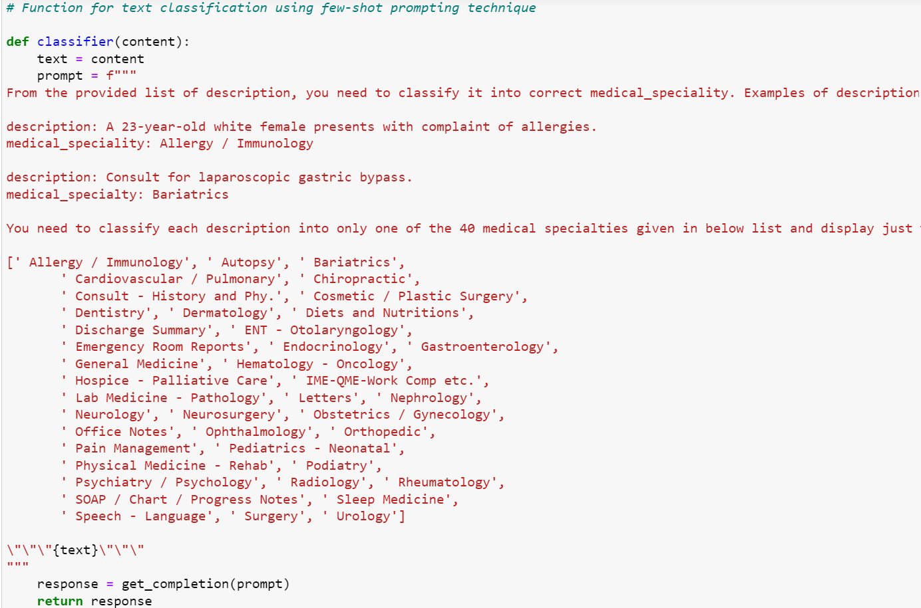
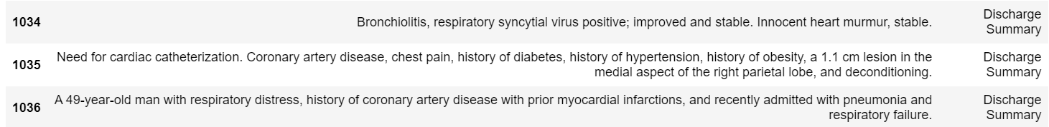
Few-shot prompting with an LLM
In few-shot prompting technique, we tune an LLM (Large Language Model) - ”gpt-3.5-turbo” using instructions.
In the instructions, we include two examples for just two out out of forty categories and then the model is used to predict the clinical domain based on the medical transcription.
The main advantages of using an instruction based LLMs are better performance with no training and very less computational cost.
Reason for less accuracy of 37.2%:
Issue with the data
Overlapping and confusing categories in the data like Discharge summary, Surgery
If we can group these categories appropriately based on the domain knowledge, it will show better results on par with the human baseline.

Slide 8
Data augmentation with NLP Augmenter
NLP Augmenter stands for "Natural Language Processing Augmentation with Replacement of Synonyms".
NLPAUG library utilizes WordNet, a lexical database for the English language, to replace words in the original text with their synonyms.
By augmenting each class with 1500 samples, we effectively addressed the issue of data imbalance
Classifier | Training Time (s) | Accuracy | Precision | Recall | F1-Score
Naive Bayes | 1.05 | 0.75 | 0.72 | 0.75 | 0.72
SVM | 9721.08 | 0.79 | 0.76 | 0.79 | 0.77
Decision Tree | 491.62 | 0.70 | 0.70 | 0.70 | 0.70
Random Forest | 604.32 | 0.76 | 0.73 | 0.76 | 0.74
K-Nearest Neighbors | 0.59 | 0.76 | 0.73 | 0.76 | 0.74
XGBoost | 3702.52 | 0.75 | 0.73 | 0.75 | 0.74
BERT | 11880.00 | 0.7553 | 0.7387 | 0.7553 | 0.7448
XLNet | 14154.93 | 0.7765 | 0.7541 | 0.7765 | 0.7608
SVM outperformed all other models in terms of F1-score with 0.77 followed by XLNet model with 0.76 but the training time of these models are substantially higher when compared to the other models.
KNN model took just 0.59 sec for training and shows moderately good F1-score with 0.74.

Slide 9
Data augmentation with SMOTE
SMOTE (Synthetic Minority Over-sampling Technique) is a data augmentation technique designed for imbalanced datasets.
SMOTE generates synthetic samples for the minority class by creating new instances that resemble existing minority class instances. It does this by interpolating between the chosen instance and its k nearest neighbors.
Classifier | Training Time (s) | Accuracy | Precision | Recall | F1-Score
Naive Bayes | 2.07 | 0.82 | 0.79 | 0.82 | 0.80
SVM | 1036.42 | 0.83 | 0.81 | 0.83 | 0.81
Decision Tree | 131.84 | 0.78 | 0.78 | 0.78 | 0.78
Random Forest | 306.14 | 0.81 | 0.81 | 0.82 | 0.81
K-Nearest Neighbors | 0.29 | 0.83 | 0.79 | 0.83 | 0.81
XGBoost | 9084.54 | 0.83 | 0.82 | 0.83 | 0.82
BERT | 6172.77 | 0.9964 | 0.9964 | 0.9964 | 0.9964
XLNet | 7896.69 | 0.9900 | 0.9901 | 0.9900 | 0.9900
BERT and XLNet models outperformed all other models in terms of F1-score with 0.99
BERT is computationally less expensive when compared to XLNet.
KNN model takes just 0.29 sec for training and but its F1-score stands at 0.81.
SMOTE data demonstrated better results than that of NLP augmenter data, especially with transformer models

Slide 10
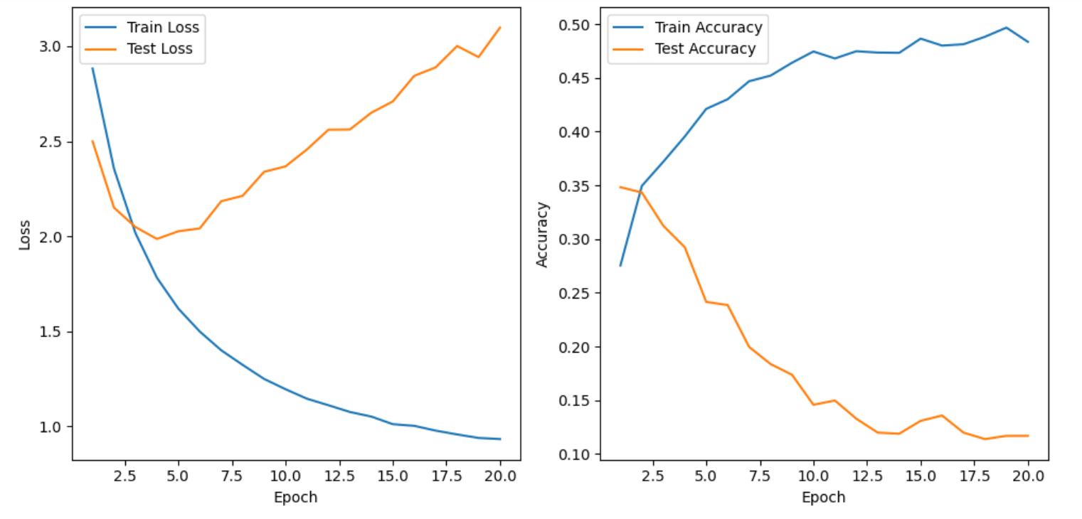
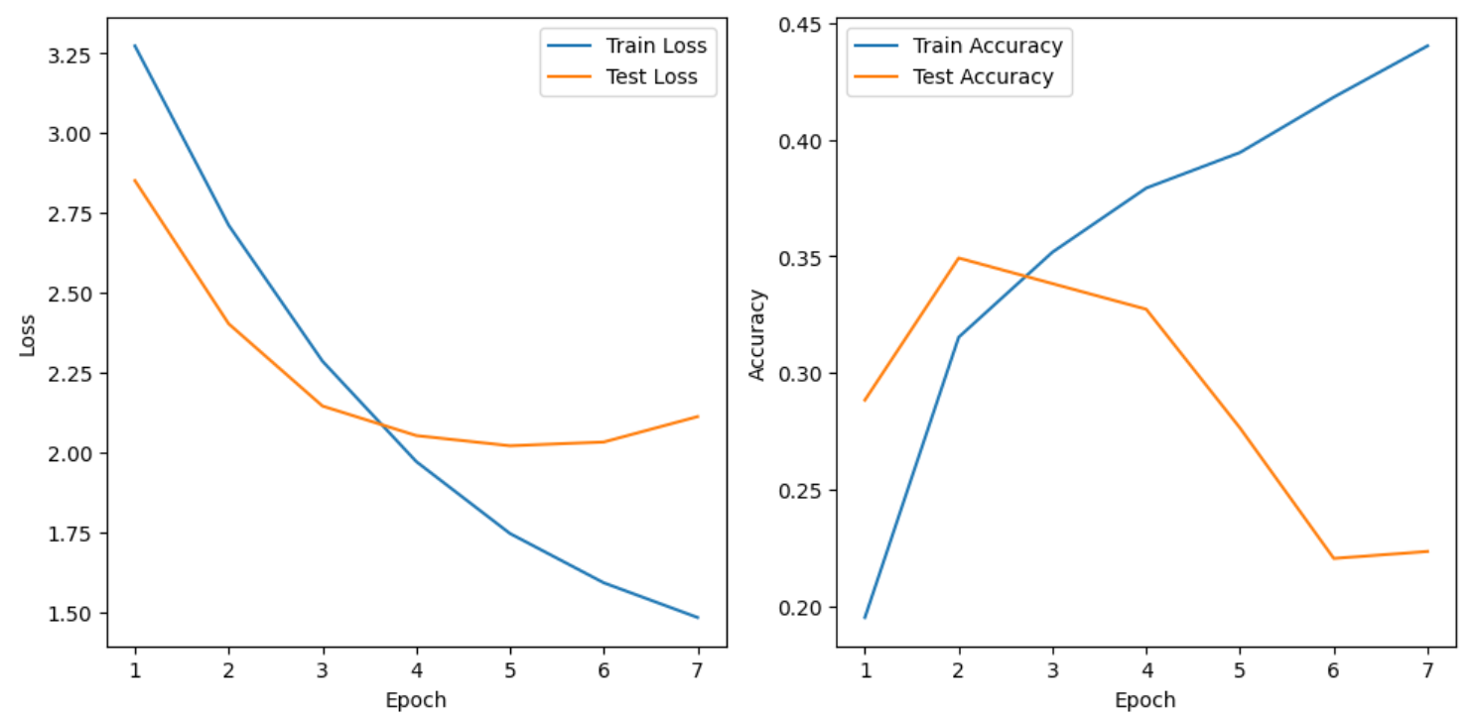
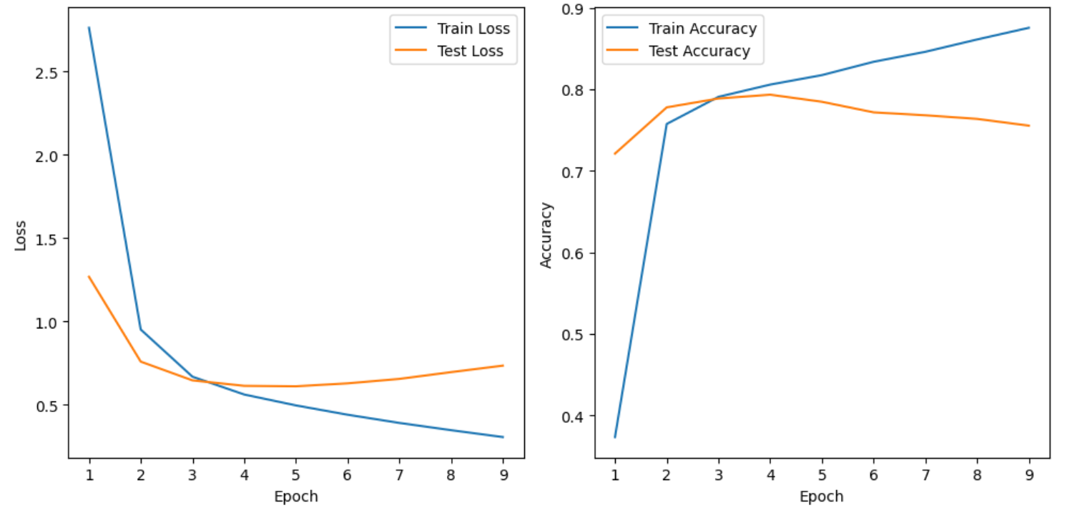
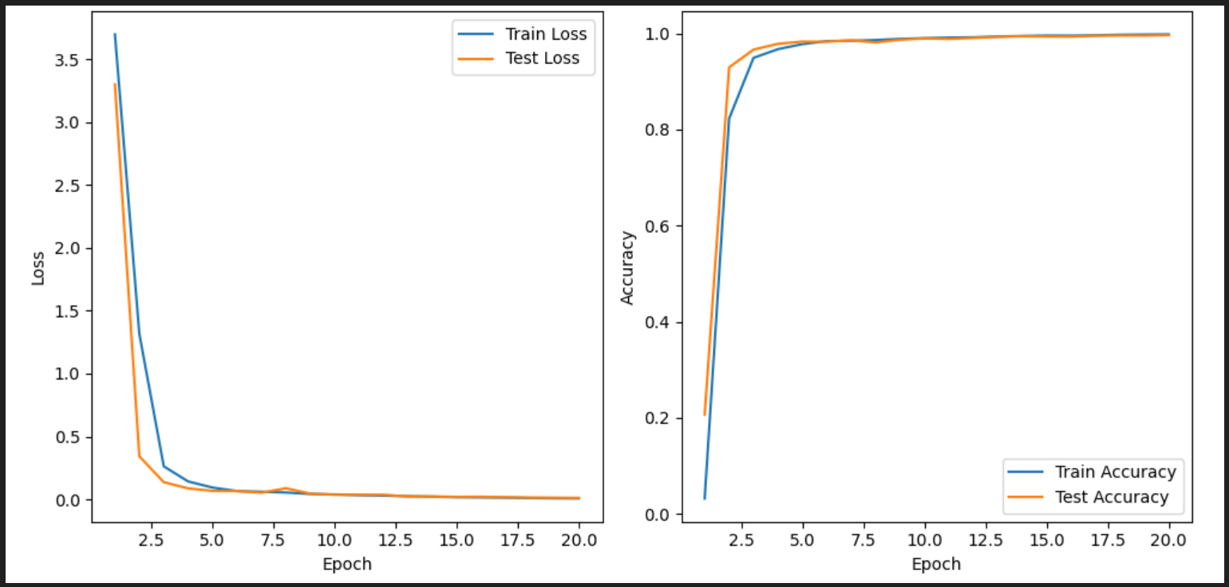
BERT model plots for loss and accuracy
Exploding gradients problem with imbalanced data
After gradient clipping with imbalanced data
Balanced data with NLP Augmenter
Balanced data with SMOTE

Slide 11


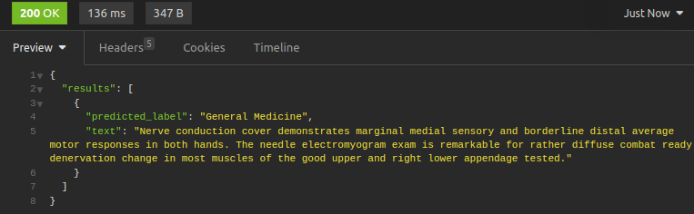
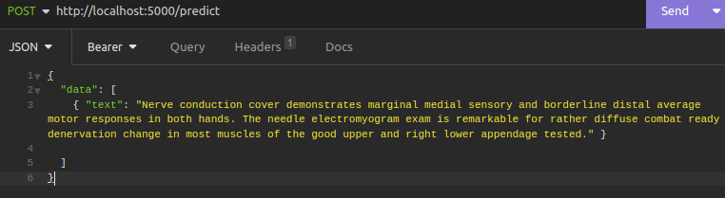
Model deployment
BERT model was deployed as it outperformed other models (Refer to SCRIPT12)
Users can send a POST request to the API with a JSON data structure.
The API tokenizes and processes the provided text data using a pre-trained language model and then predicts the medical domain or specialty associated with each text entry.
The API responds with a JSON structure containing predictions and original text. Each result includes the predicted medical domain and the corresponding input text.

Slide 12
Challenges
Conclusion
Github link
Imbalanced data : Handled with NLP Augmenter and SMOTE
Exploding gradients: Handled using techniques like gradient clipping and adjusting the learning rate schedule.
Computational resources: Training and predicting with transformer-based models like BERT and XLNet can be computationally intensive. However, BERT is less expensive compared to XLNet.
Overfitting with augmented data: Augmented data may introduce the risk of overfitting.
BERT model outperformed all other models in terms of F1-score with 0.99 and is computationally less expensive than XLNet.
Our future work aims to focus on gathering more real medical transcriptions data instead of generating synthetic samples and then these models will be evaluated to identify the best model for this task of clinical domain classification.
Datasets, Scripts and Research paper are available in the github link given below:
https://github.com/LakshmikarPolamreddy/Clinical_domain_classification_final_project_NLP

Slide 13
Team Responsibilities
GROUP 5
Lakshmikar Polamreddy
Harsha Koduri
Sai Kumar Kalisetty
Tirupati Kadari
Project management and planning
Project Proposal
Data preparation and profiling
Model building and tuning
Research paper
Slide deck for final presentation
Data collection and data scraping
Data preparation
Model building and tuning
Model deployment
Slide deck for final presentation
Data collection and data scraping
Model building
Research paper
Model building
Slide deck for final presentation
Research paper

Slide 14





Project Milestones & Timeline
07-03-2023
07-31-2023
Planning
Present project proposal
Collect required datasets
Assign roles and responsibilities with due dates
Model building
Build traditional classifier models, pre-trained BERT and XLNet models and Few-shot prompting
Deliver & Present
Write a research paper
Present final solution to class
Data collection and Pre-processing
Scrape data from the website
Pre-process the data
Handle data imbalance
Validation and Deployment
Test the model and finetune it
Deploy the model using Flask
06-26-2023
07-24-2023
08-07-2023

Slide 15
Thank you!

